Slide 1
Tutorial on VoiceSauce - A program for voice analysis
Yuan Chai
University of Washington
yuanchai@uw.edu
11/13/2023

Slide 2
What is VoiceSauce
VoiceSauce is a software that can be used to analyze acoustic measurements related to voicing (Shue et al., 2010).
Compared to Praat, VoiceSauce specializes in measuring parameters related to voice quality:
Spectral tilt (H1-H2, H2-H4), noise (HNR), voicing amplitude (SoE). Those measures indicate whether there is glottal constriction or F0 irregularity in the voicing.
VoiceSauce can also calculate measures that Praat can calculate:
Pitch (F0), vowel formant, duration, intensity (RMS Energy)

Slide 3
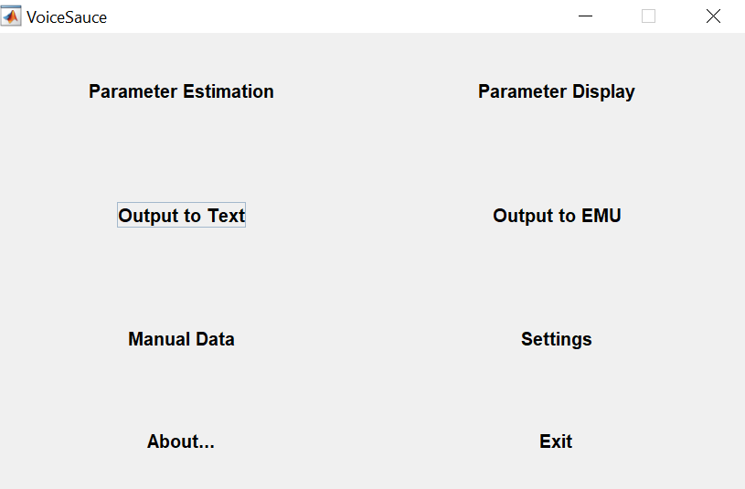
What does VoiceSauce look like
If you want to visualize the data in VoiceSauce
Step 2
Step 3
If you spot errors in the output and want to manually add data
Step 1

Slide 4
Output from VoiceSauce
VoiceSauce output one datapoint every 1 millisecond.
VoiceSauce can also calculate mean
Either the overall mean,
Or you can specify how many intervals you want to divide a sound file into, and calculate the mean of each interval.

Slide 5
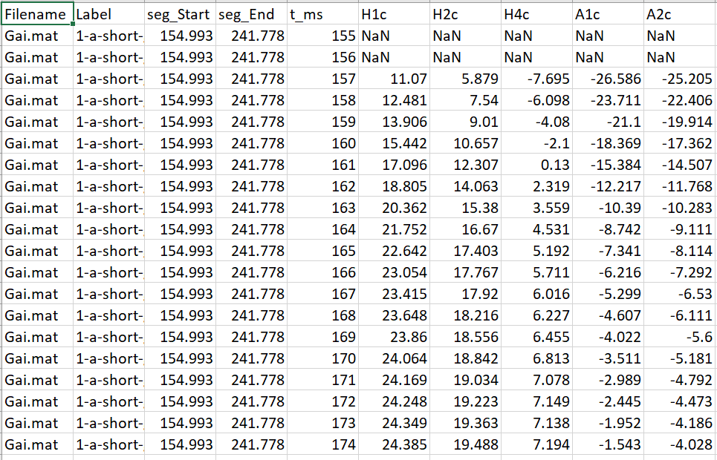
All data points:

Slide 6
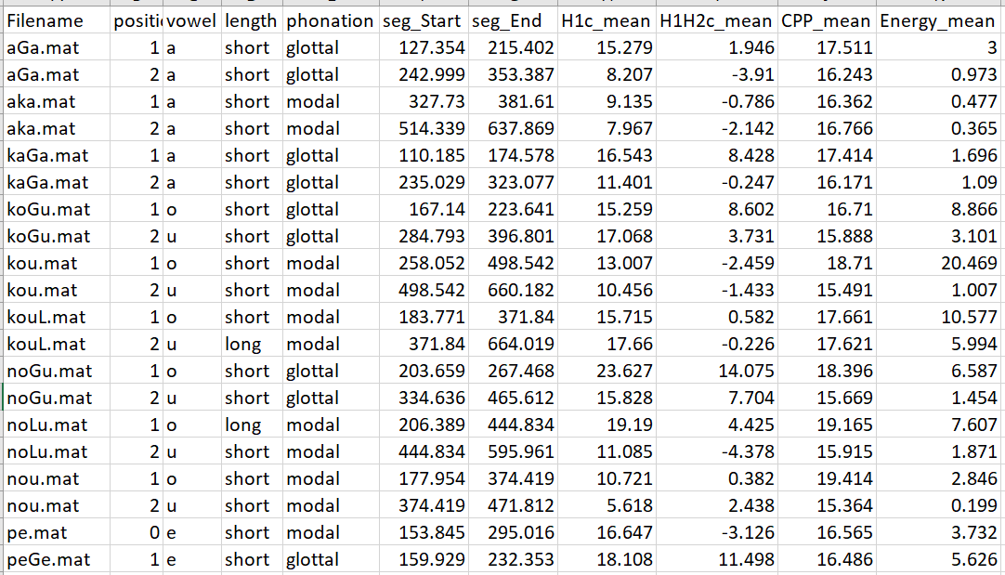
Just the mean

Slide 7
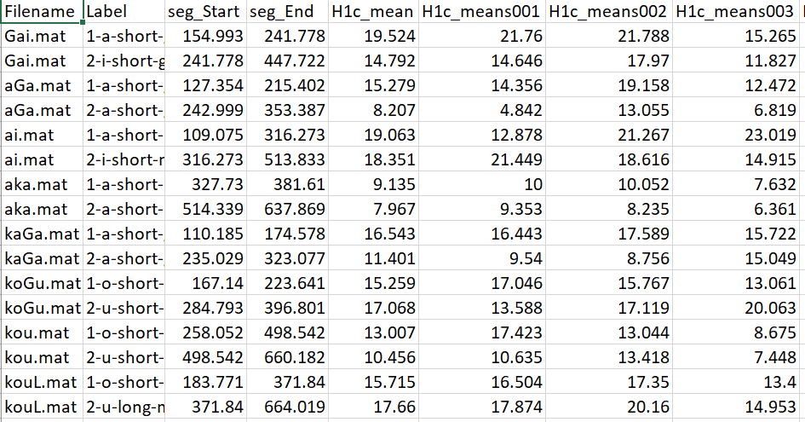
Means of three equal-timed intervals for each file

Slide 8
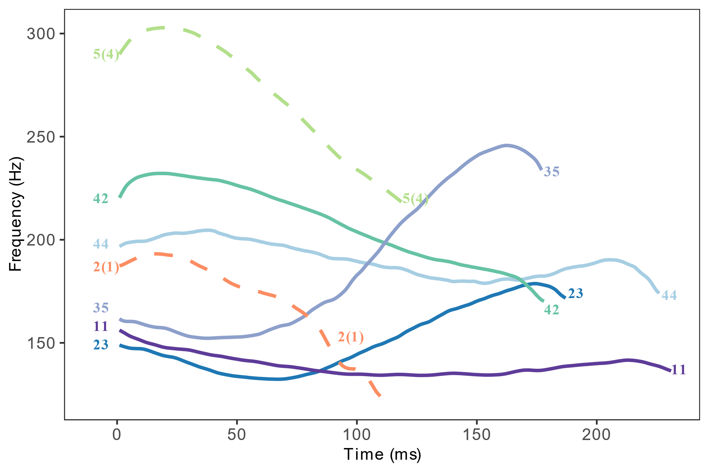
What can you draw/analyze using output from VoiceSauce
Pitch track (F0 track of the seven tones in Xiapu Min)

Slide 9
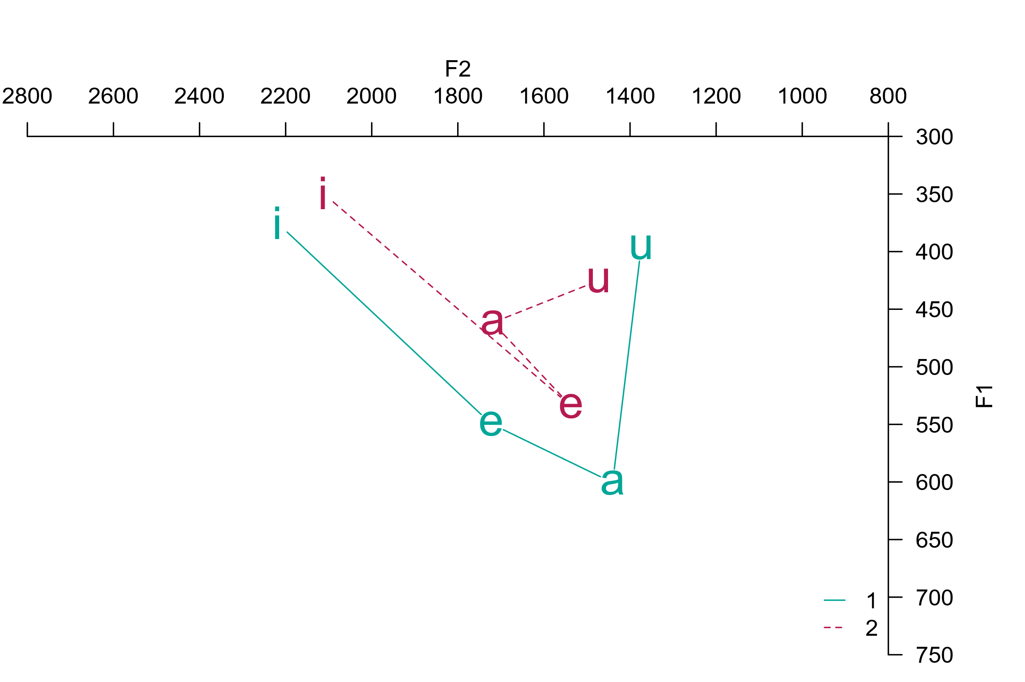
What can you draw/analyze using output from VoiceSauce
Vowel chart (stressed and unstressed vowels in Cahuilla)

Slide 10
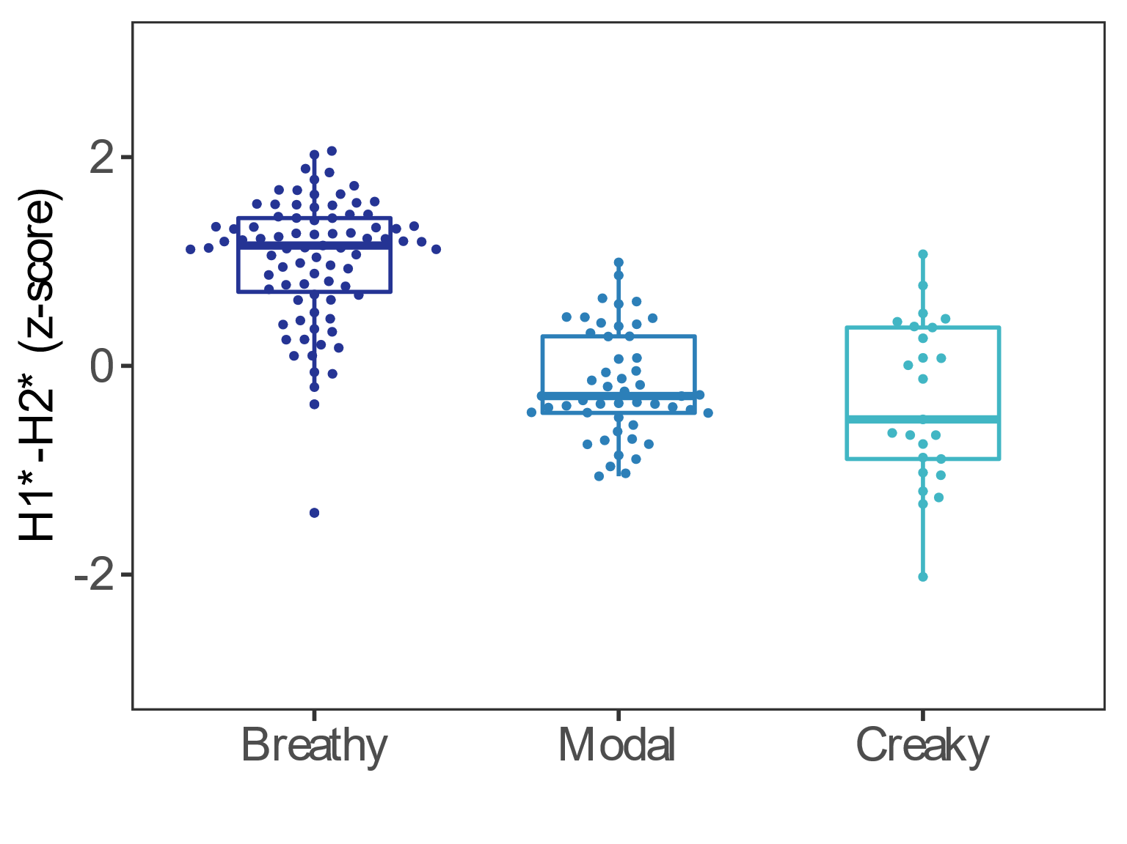
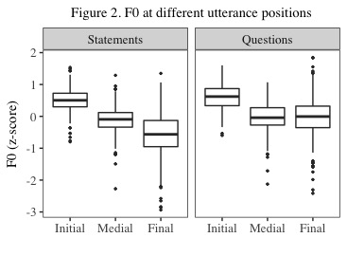
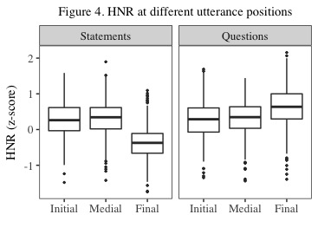
What can you draw/analyze using output from VoiceSauce
Boxplots of various measures
H1*—H2*
F0
Harmonic-to-noise ratio

Slide 11
Summary of the parameters
F0: F0 from Straight (strF0), Snack (sF0), Praat (pF0), Subharmonic to harmonic ratio F0 (shrF0)
Formant: Formant frequencies and bandwidths by Snack (sF1, sF2) and by Praat (pF1, pF2)
Spectral measures: H1, H2, H1H2c, H2H4c
Energy: Energy (overall); Strength of Excitation (SoE)
Noise: Cepstral Peak Prominence (CPP); Harmonic to noise ratios: HNR05 (0-500Hz), HNR15 (0-1500Hz), HNR25 (0-2500Hz), HNR35 (0-3500Hz), Subharmonic to harmonic ratio: SHR

Slide 12
Notes on harmonic amplitude correction
“The purpose of this correction formula is to ‘undo’ the effects of the formants on the magnitudes of the source spectrum. This is done by subtracting the amount by which the formants boost the spectral magnitudes.” (Iseli et al., 2007, p. 2285)

Slide 13
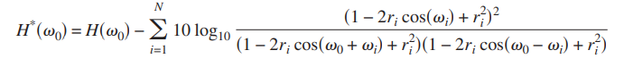
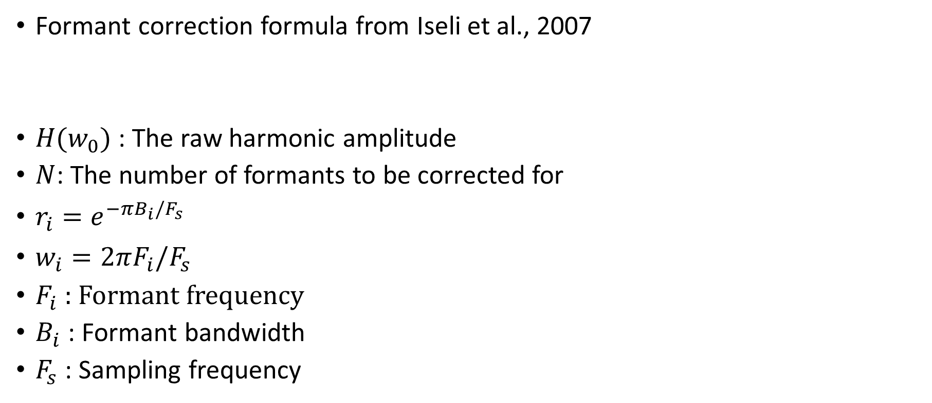
Notes on harmonic amplitude correction
Formant correction formula from Iseli et al., 2007
${H(w}_{0})$ : The raw harmonic amplitude
$N$: The number of formants to be corrected for
$r_{i}=e^{−πB_{i}/F_{s}}$
$w_{i}=2πF_{i}/F_{s}$
$F_{i}$ : Formant frequency
$B_{i}$ : Formant bandwidth
$F_{s}$ : Sampling frequency

Slide 14
Notes on harmonic amplitude correction
The correction becomes negative when a high-frequency harmonic is being corrected for a low-frequency formant
Given:
#harmonic being corrected f = 2000
#formant to correct Fx = 450
#bandwidth of the formant being corrected
Bx = 34
#sampling rate Fs = 44100
Correction = -25.39
Meaning that the correction of the formant at 450 Hz boosts the harmonic at 2000 Hz by 25.39 db

Slide 15
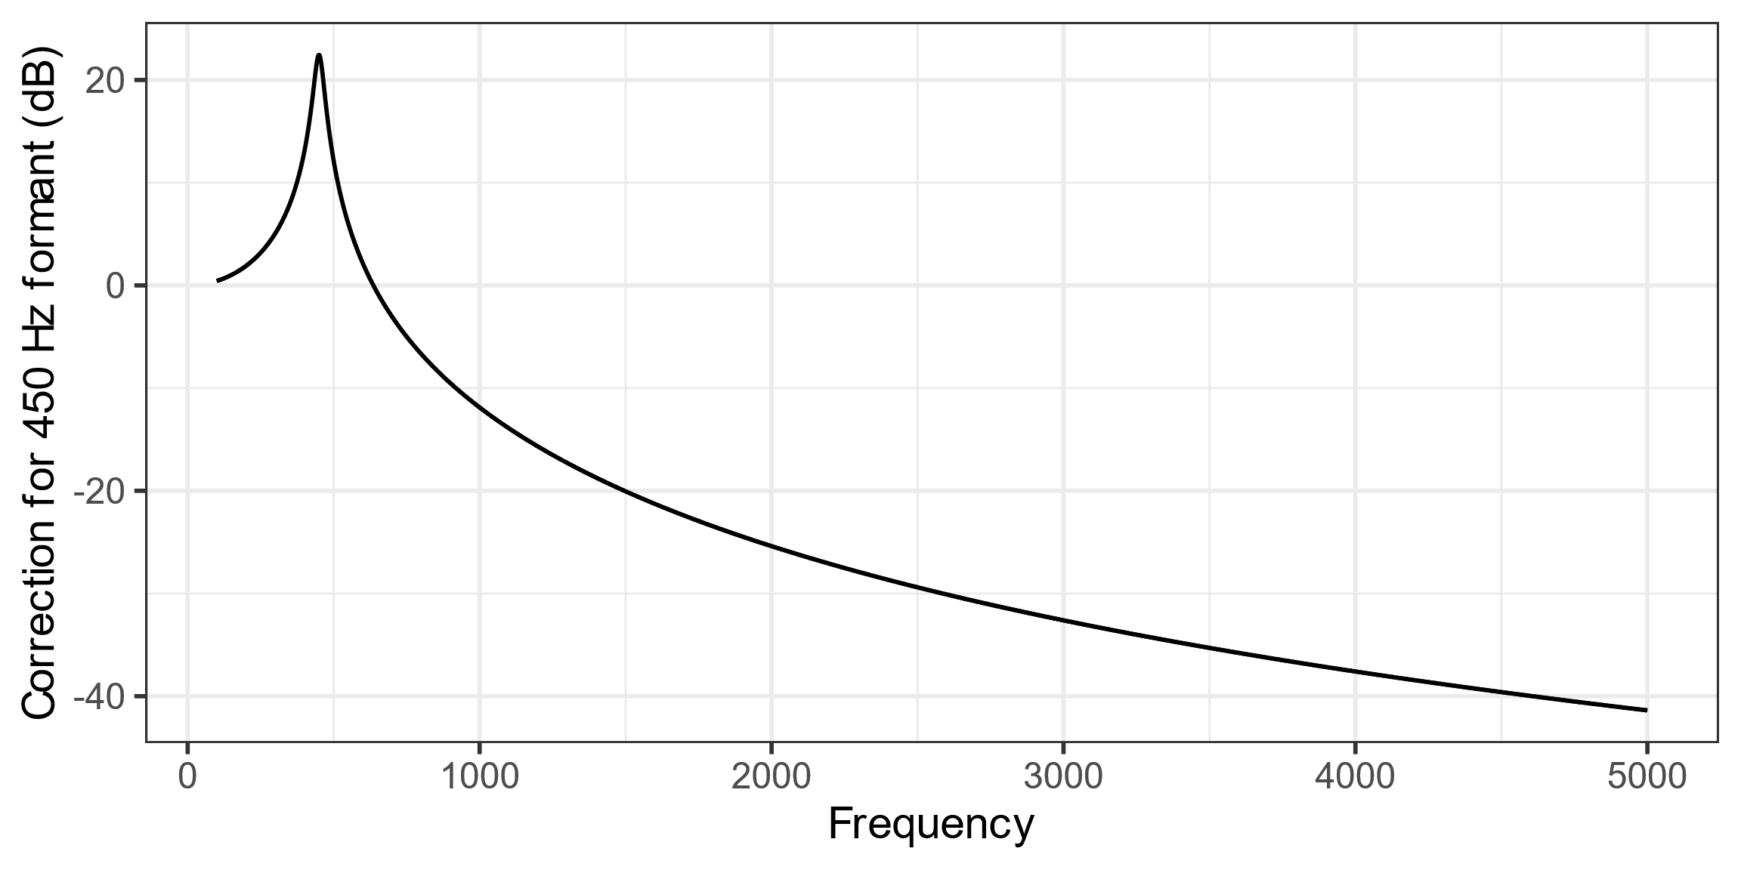
Notes on harmonic amplitude correction
The correction value of a formant at 450 Hz for harmonics from 100 to 5000 Hz

Slide 16
Notes on harmonic amplitude correction
Cautions about the harmonic correction
Does the correction formula really account for the attenuation of the formants on harmonics (i.e. does F1 at 450 Hz actually attenuates 25 dB on a 2000 Hz harmonic?)
Notes from Yen Shue:
“Maybe the correction of formants shouldn't be applied on formants that are too far away from the harmonic of interest.”

Slide 17
Notes on harmonic amplitude correction
The default formant correction setting (cannot be changed from the GUI. If you want to change what formants are being corrected for which harmonic, you need to change the MATLAB code.)
H1: F1, F2
H2: F1, F2
H4: F1, F2
A1 (the harmonic closest to F1): F1, F2
A2 (the harmonic closest to F2): F1, F2
A3 (the harmonic closest to F3): F1, F2, F3
H2K (the harmonic closest to 2K): F1, F2, F3
H5K (the harmonic closest to 5K): not corrected

Slide 18
Notes on harmonic amplitude calculation
For raw harmonic amplitude calculation:
The estimation of the harmonic amplitude depends on the estimation of f0. If the f0 is not correctly tracked, the harmonic frequency is not correctly tracked.
If you detect f0 errors, you can either manually correct it in VoiceSauche “Manual” option, or throw that data point away from harmonic amplitude measures.
For corrected harmonic amplitude calculation:
The correction of harmonic amplitude depends on the correct tracking of:
f0
Formant
If you detect f0 or formant tracking errors, you can either manually correct it in VoiceSauce “Manual” option, or throw that data point away from harmonic amplitude measures.

Slide 19
Sample research questions:
Is the consonant pre-glottalized or post-glottalized?
Are vowels following ejectives more glottalized than vowels following non-ejectives?
Do implosive have stronger voicing than non-implosive?
Does vowel quality differ between stressed and unstressed syllables?
Do vowels after voiceless stops have a higher F0 than vowels after voiced stops?
What is the F0 contour and shape of the tones in the language?
Do vowels following aspirated stops have a breathy voice quality?

Slide 20
How to download and use VoiceSauce
Windows users: Standalone .exe file
Mac users: Install Matlab and run the scripts in Matlab
Refer to https://yuanchaiyc.github.io/website/subpages/VS-tutorial.html for detailed installation instructions

Slide 21
Case study for today
The acoustics of V and VʔV in Hawaiian
Hawaiian has phonemic glottal stop:
aha | “what”
ʔaha | “line, life”
noːu | “yours”
noʔu | “mine”
(Data and recordings from the UCLA Phonetics Lab Archive http://archive.phonetics.ucla.edu/Language/HAW/haw_word-list_1973_01.html#1)

Slide 22

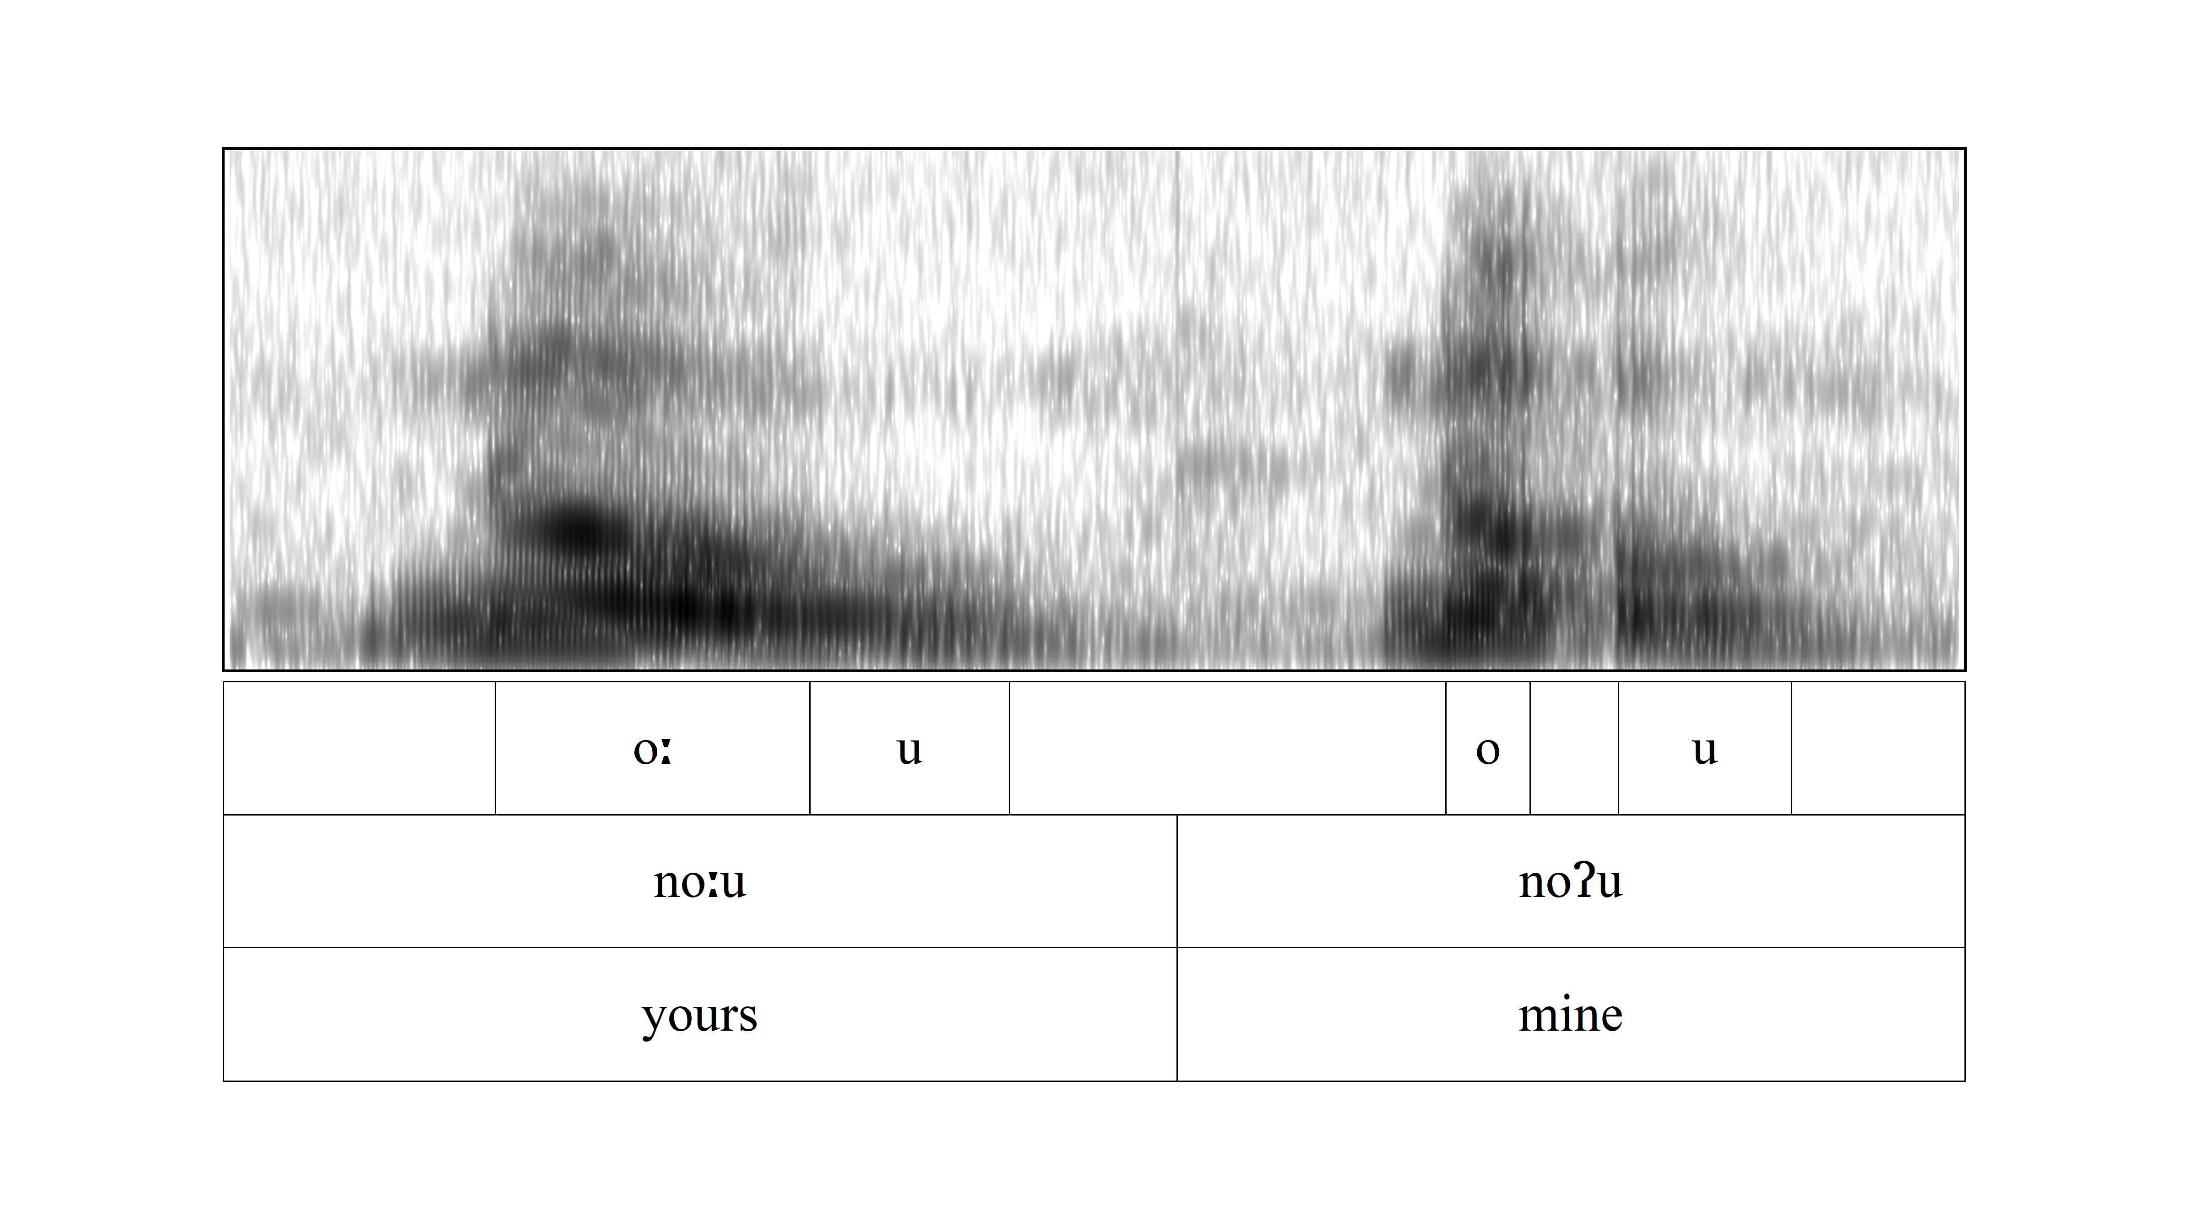
Case study for today
Research question: Are the vowels surrounding the glottal stop creakier than the plain vowels?
noːu vs. noʔu

Slide 23
Case study for today
Word list:
word | gloss | word | gloss | word | gloss
pe | "thus" | peːpeː | "crushed" | peʔe | "to hide (oneself)"
nou | "to throw" | noːu | "yours" | noʔu | "mine"
kou | "yours" | kouː | "moist" | koʔu | "mine"
aka | "shadows" |  |  | aʔa | "roots"
 |  |  |  | kaʔa | "to roll"

Slide 24
Case study for today
Parameters of interest:
F0
Harmonic amplitude: H1, H1—H2
The lower the harmonic amplitude, the more glottal constriction
Noise: Harmonic-to-noise ratio (HNR05, meaning between 0 to 500 Hz)
The lower the HNR, the noisier the signal
Amplitude of voicing: Strength of excitation (SoE)
Glottalization tends to results in lower amplitude in voicing (SoE)

Slide 25
Getting started
Prepare data in Praat
Create a Textgrid
Segment and annotate the target segment
Save the Textgrid
either as for the whole recording
or split the recording into individual target words – RECOMMENDED
You can use Praat scripts or Praat plugins to chop a long recordings into smaller chunks. Come talk to me if you want to know more about the tools!

Slide 26
Getting started
Annotation strategy for the current task
Segment out each vowel (monophthongs or nuclei and glide in dipthongs)
e.g. [peːpeː] → Segment out two [eː]s
e.g. [nou] → Segment out [o] and [u]
Assign label at the word level and the segment level
Word level: peLpeL (use “L” to replace diacritic [ː] because VS does not allow special symbols)
Segment level:
1-e-long-modal
position-vowel-length-phonation

Slide 27
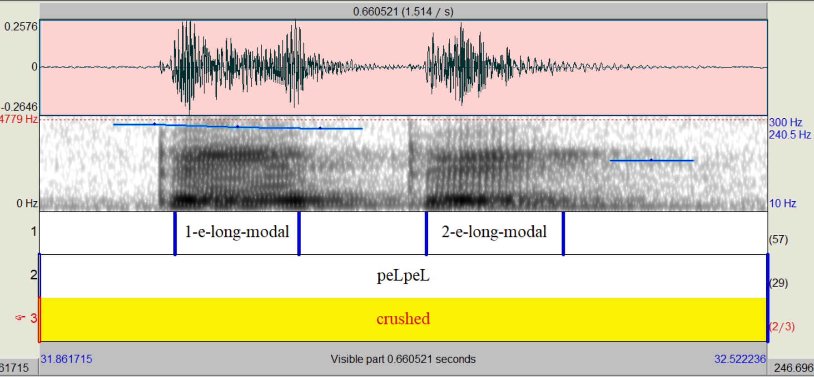
Getting started

Slide 28
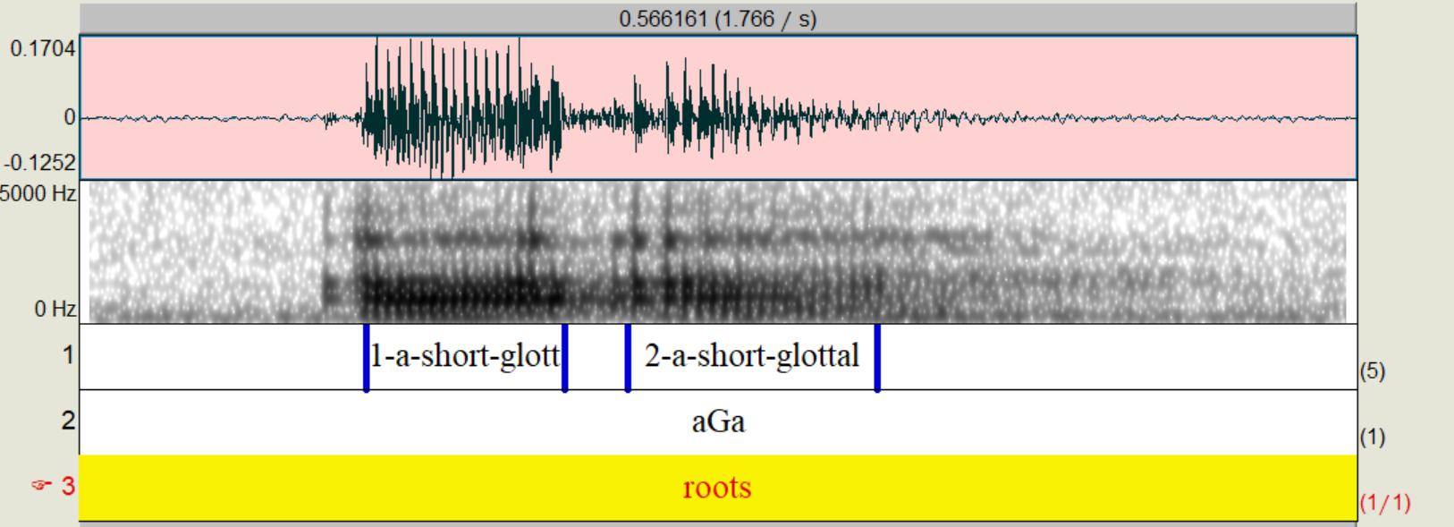
Getting started

Slide 29
Getting started
Download the preprocessed data here:
https://yuanchaiyc.github.io/website/subpages/sample/Hawaiian_data.zip

Slide 30
Pass on the .wav and .Textgrid to VoiceSauce
Step 1

Slide 31
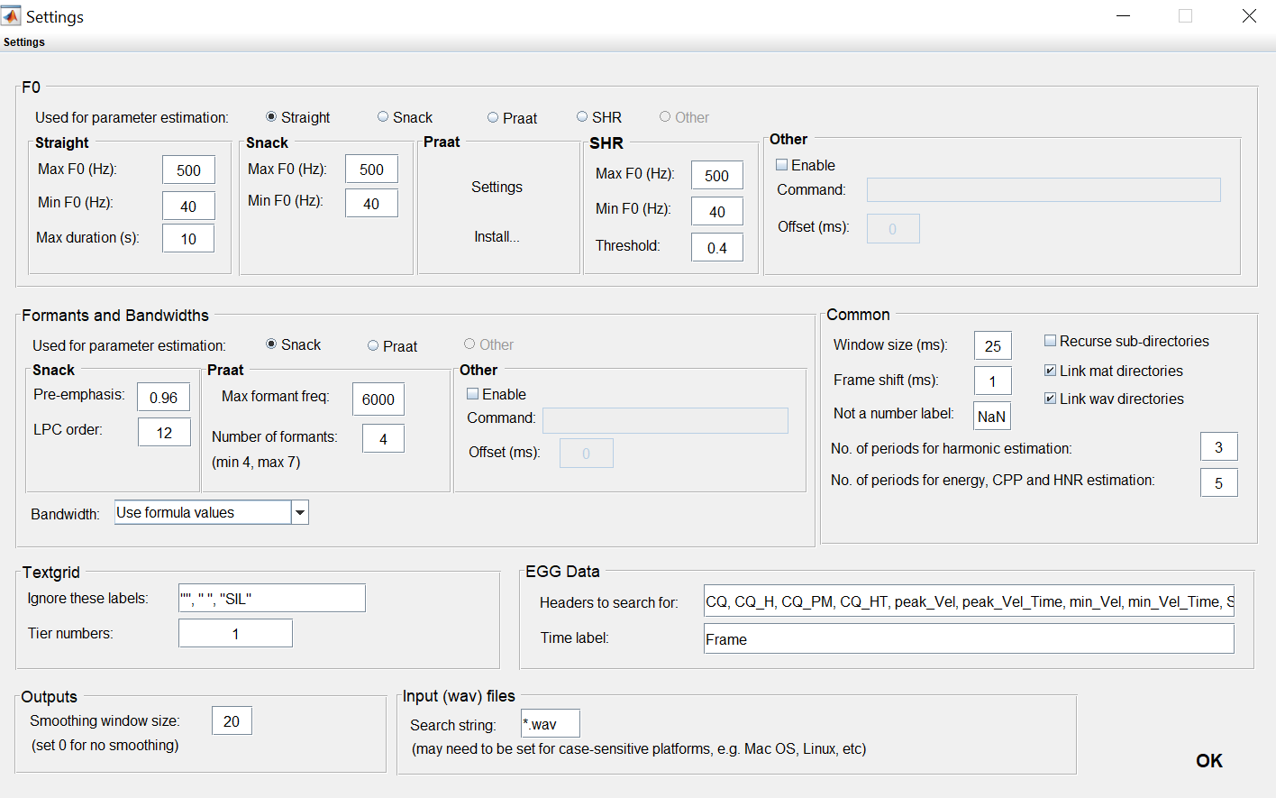
Step 1: Settings

Slide 32
Step 2: Parameter estimation
Step 2

Slide 33
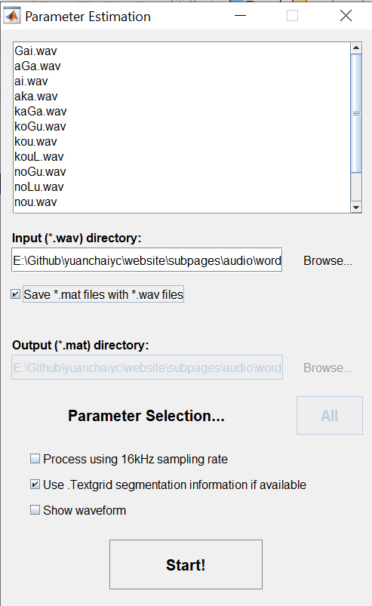

Slide 34
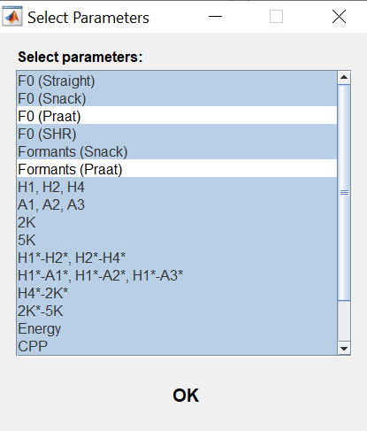
Step 2: Parameter estimation
If you are using Matlab online, make sure you deselect all the measures involving Praat.

Slide 35
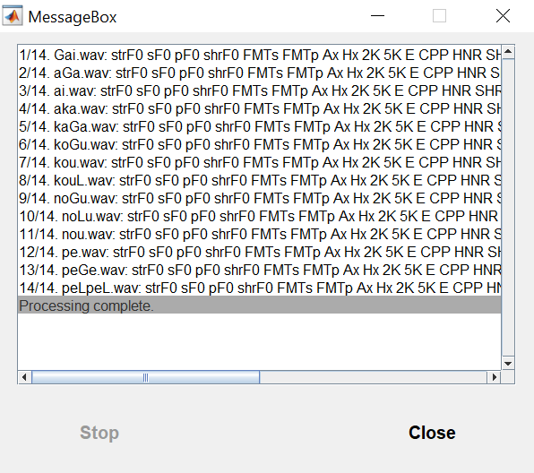
Step 2: Parameter estimation

Slide 36
Step 3: Output to text
Step 3

Slide 37
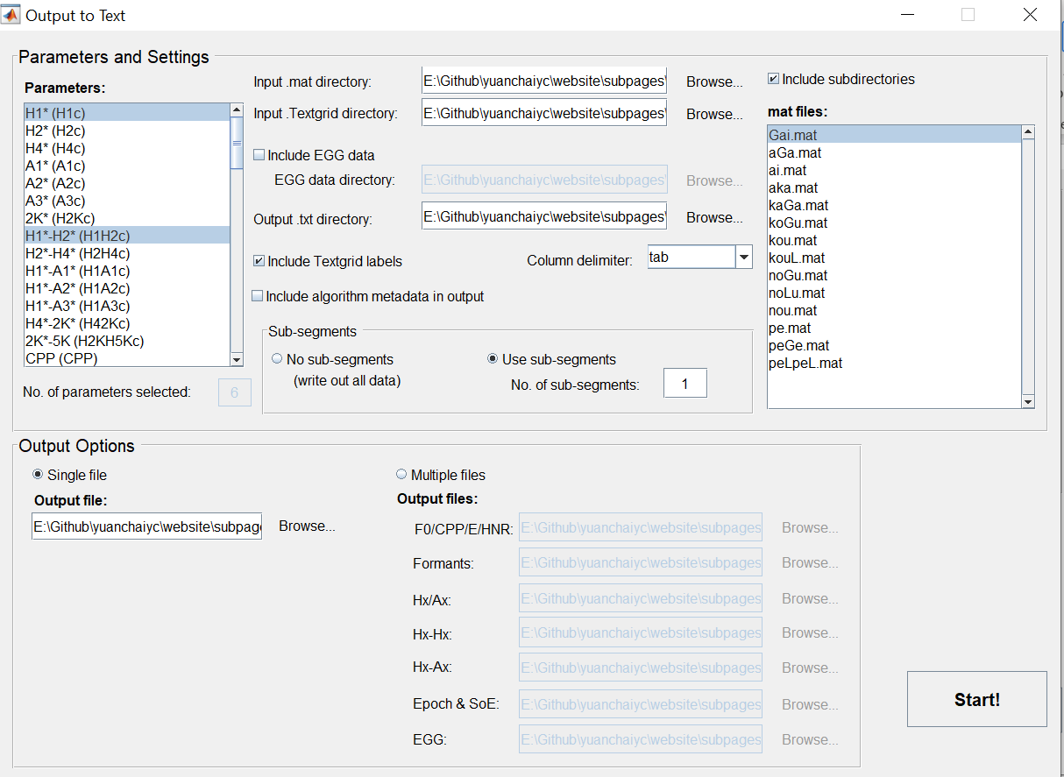
Parameters to select for today:
H1*
H1*-H2*
HNR05
strF0
sF1
sF2
SoE

Slide 38
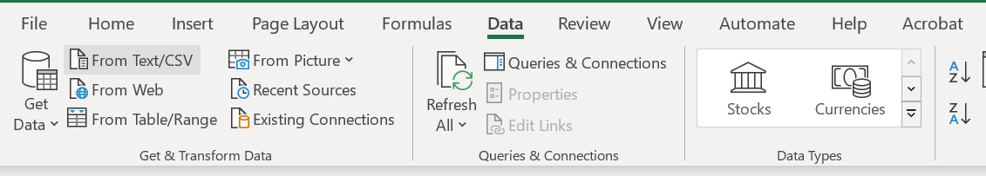
Step 4: Visualize the output in Excel
Open output.txt in Excel:
Open Excel → Data → From Text/CSV

Slide 39
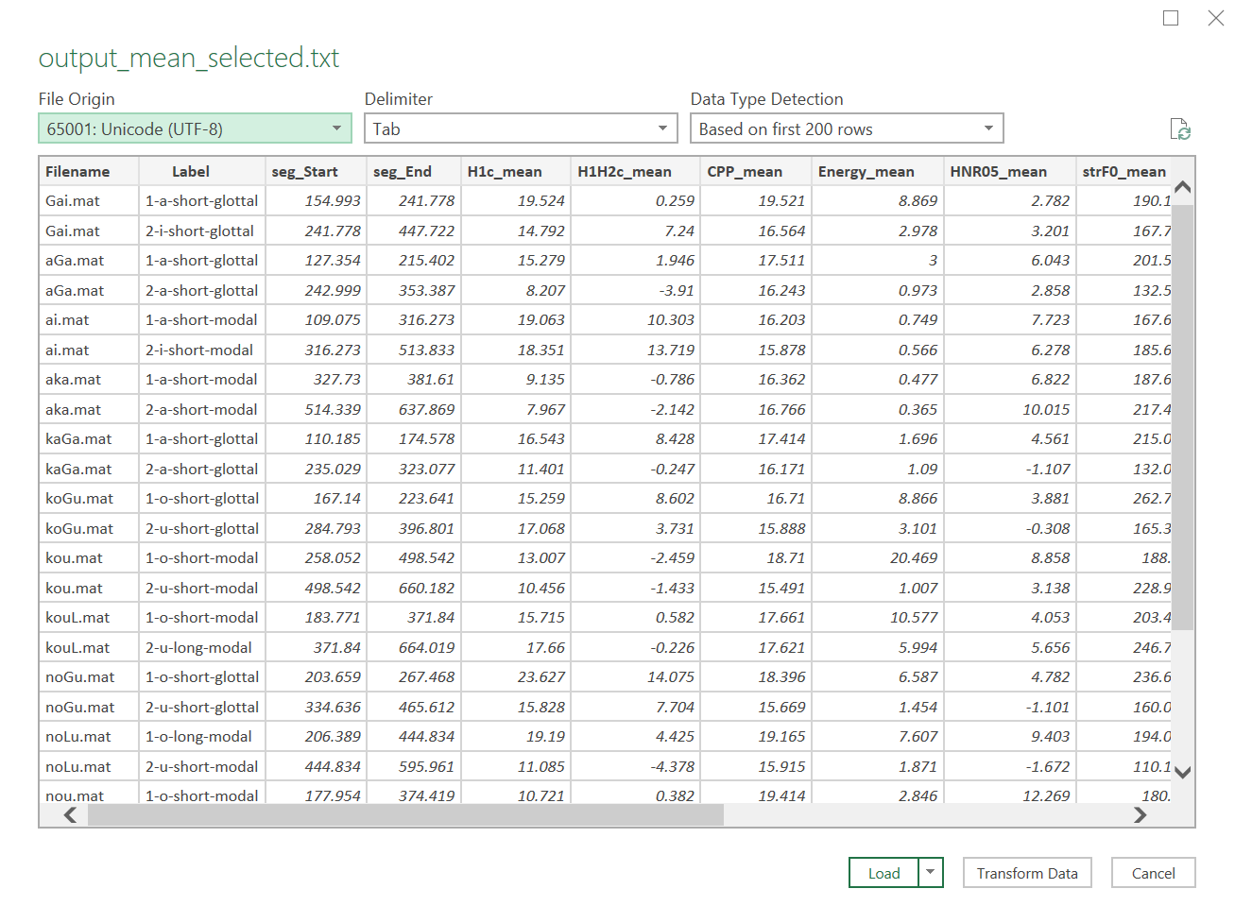

Slide 40
Step 4: Visualize the output in Excel
Open output.txt in Excel:
Open Excel → Data → From Text/CSV;
Load the data;
Save the data file as a .xlsx file.

Slide 41
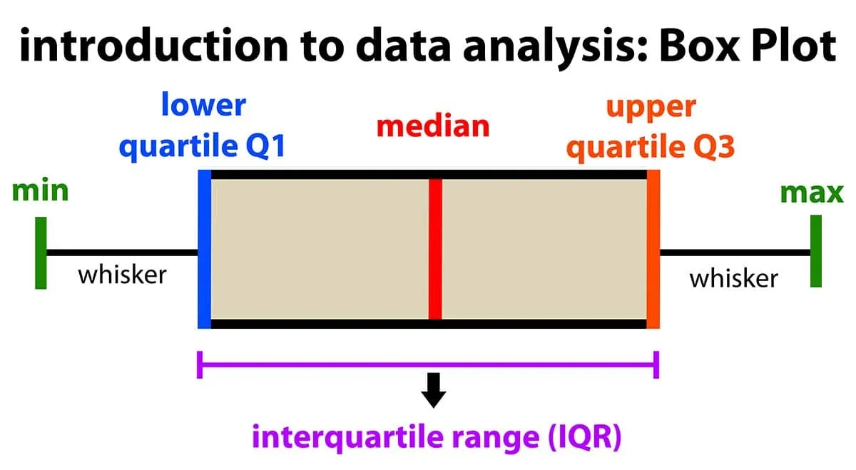
Step 4: Visualize the output in Excel
Draw boxplots:
Boxplots present the median, first and third quantile, and the minimum and maximum of the data.
Picture from https://www.simplypsychology.org/boxplots.html

Slide 42
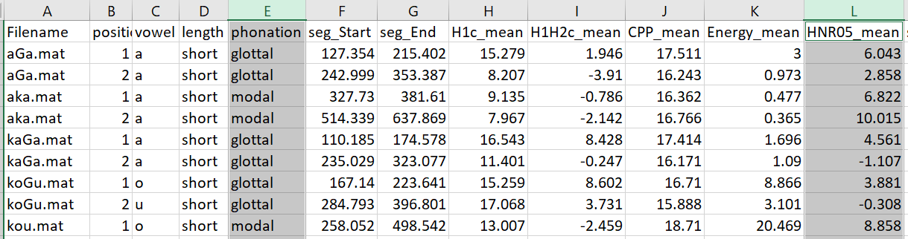
Step 4: Visualize the output in Excel
Draw boxplots: H1-H2 distribution of modal vs. glottalized phonation
Select the column of “phonation”; Press “ctrl” on the keyboard, and Select the column of “H1H2c_mean”

Slide 43

Step 4: Visualize the output in Excel
Draw boxplots: HNR distribution of modal vs. glottalized phonation
Select the column of “phonation”; Press “ctrl” on the keyboard, and Select the column of “HNR05_mean”
Go to Insert → Charts → All charts → Box & Whisker → Press “OK”

Slide 44
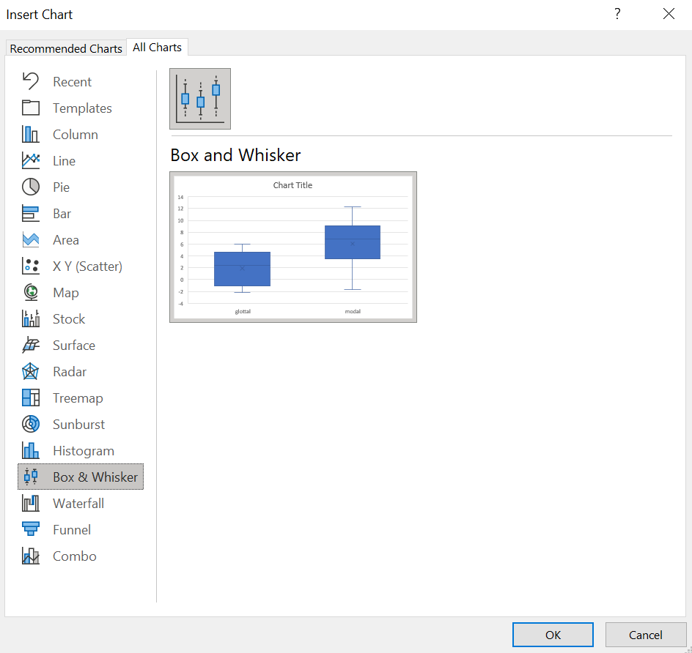

Slide 45
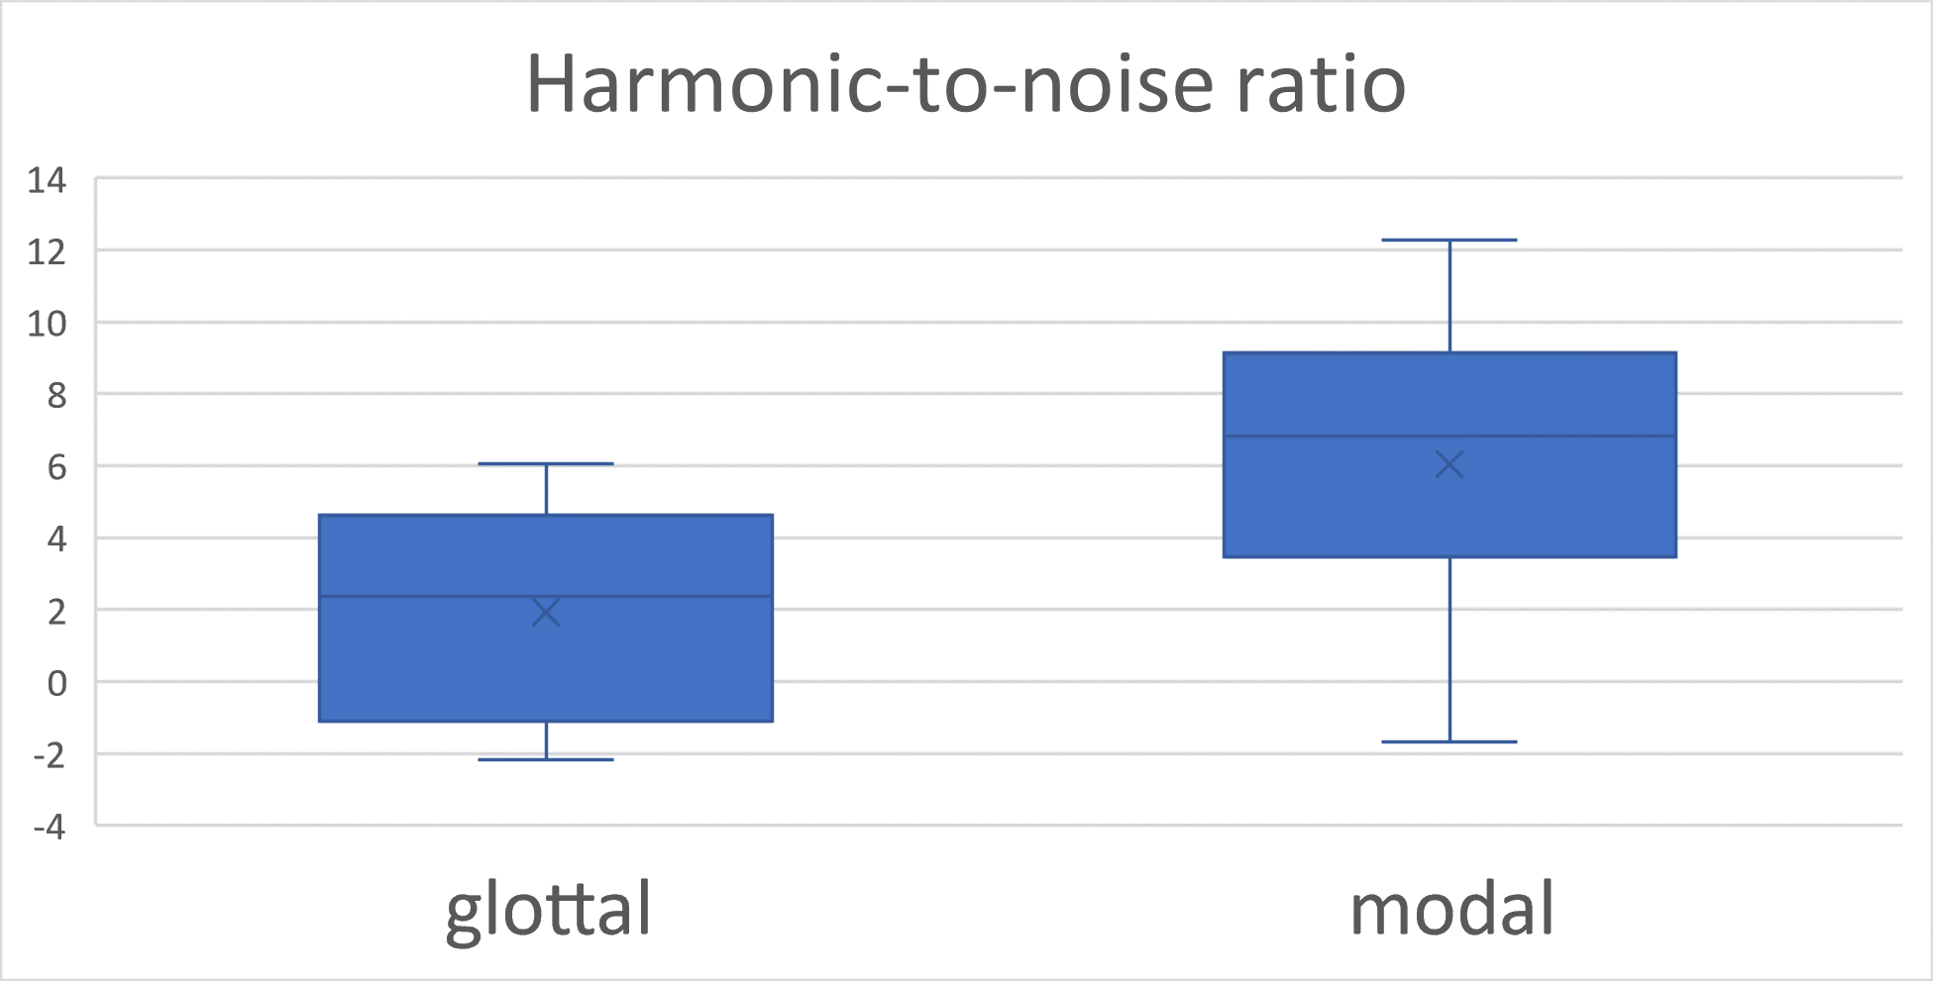
Step 4: Visualize the output in Excel
Draw boxplots: HNR distribution of modal vs. glottalized phonation
More glottalized
We see that vowels surrounding glottal stops have lower HNR than vowels that do not.
This indicates that vowels in VʔV words are more glottalized than vowels in V or VV words.

Slide 46
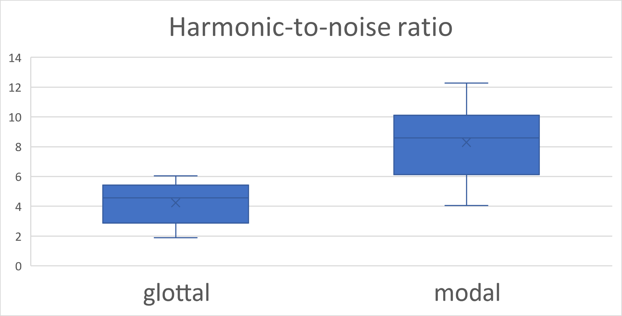
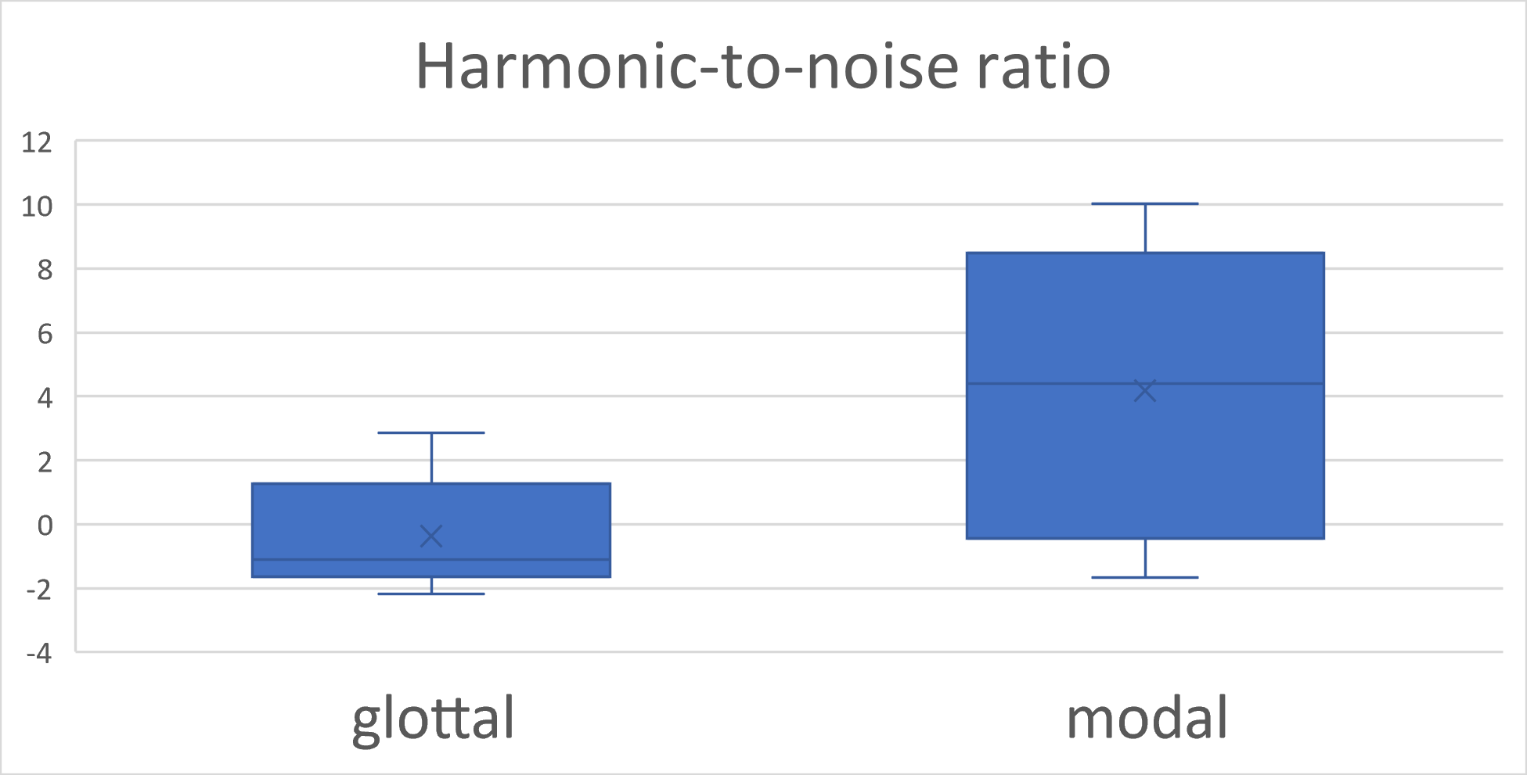
Step 4: Visualize the output in Excel
Draw boxplots: HNR distribution of modal vs. glottalized phonation
You can filter the data and see how the plot changes.
Filter the “position” column by only selecting “1”
Then filter the “position” column by only selecting “2”
Position 1
Position 2
More glottalized

Slide 47
Step 4: Visualize the output in Excel
Let’s try more graphsǃ
Draw boxplots for H1H2c_mean (H1—H2), soe_mean (Strength of Excitation), strF0 (F0 using “straight” algorithm)

Slide 48
Step 4: Visualize the output in Excel
Let’s try drawing graphs in R
R studio online: https://posit.cloud/content/5398051
R script offline: https://yuanchaiyc.github.io/website/subpages/VS-tutorial.Rmd

Slide 49
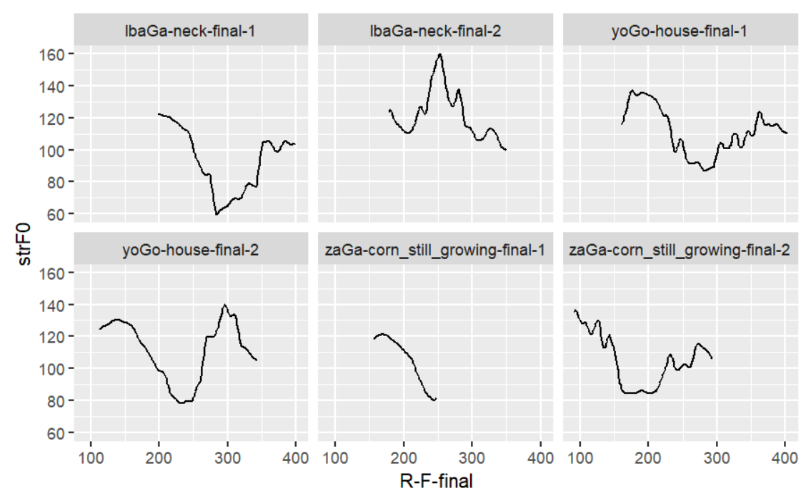
Outlier detection for f0, formant, and harmonic measures
f0 tracking error detection:
f0 is frequently wrongly-tracked for creaky phonation. I recommend plot the f0 track for each token and manually check the f0 track.

Slide 50
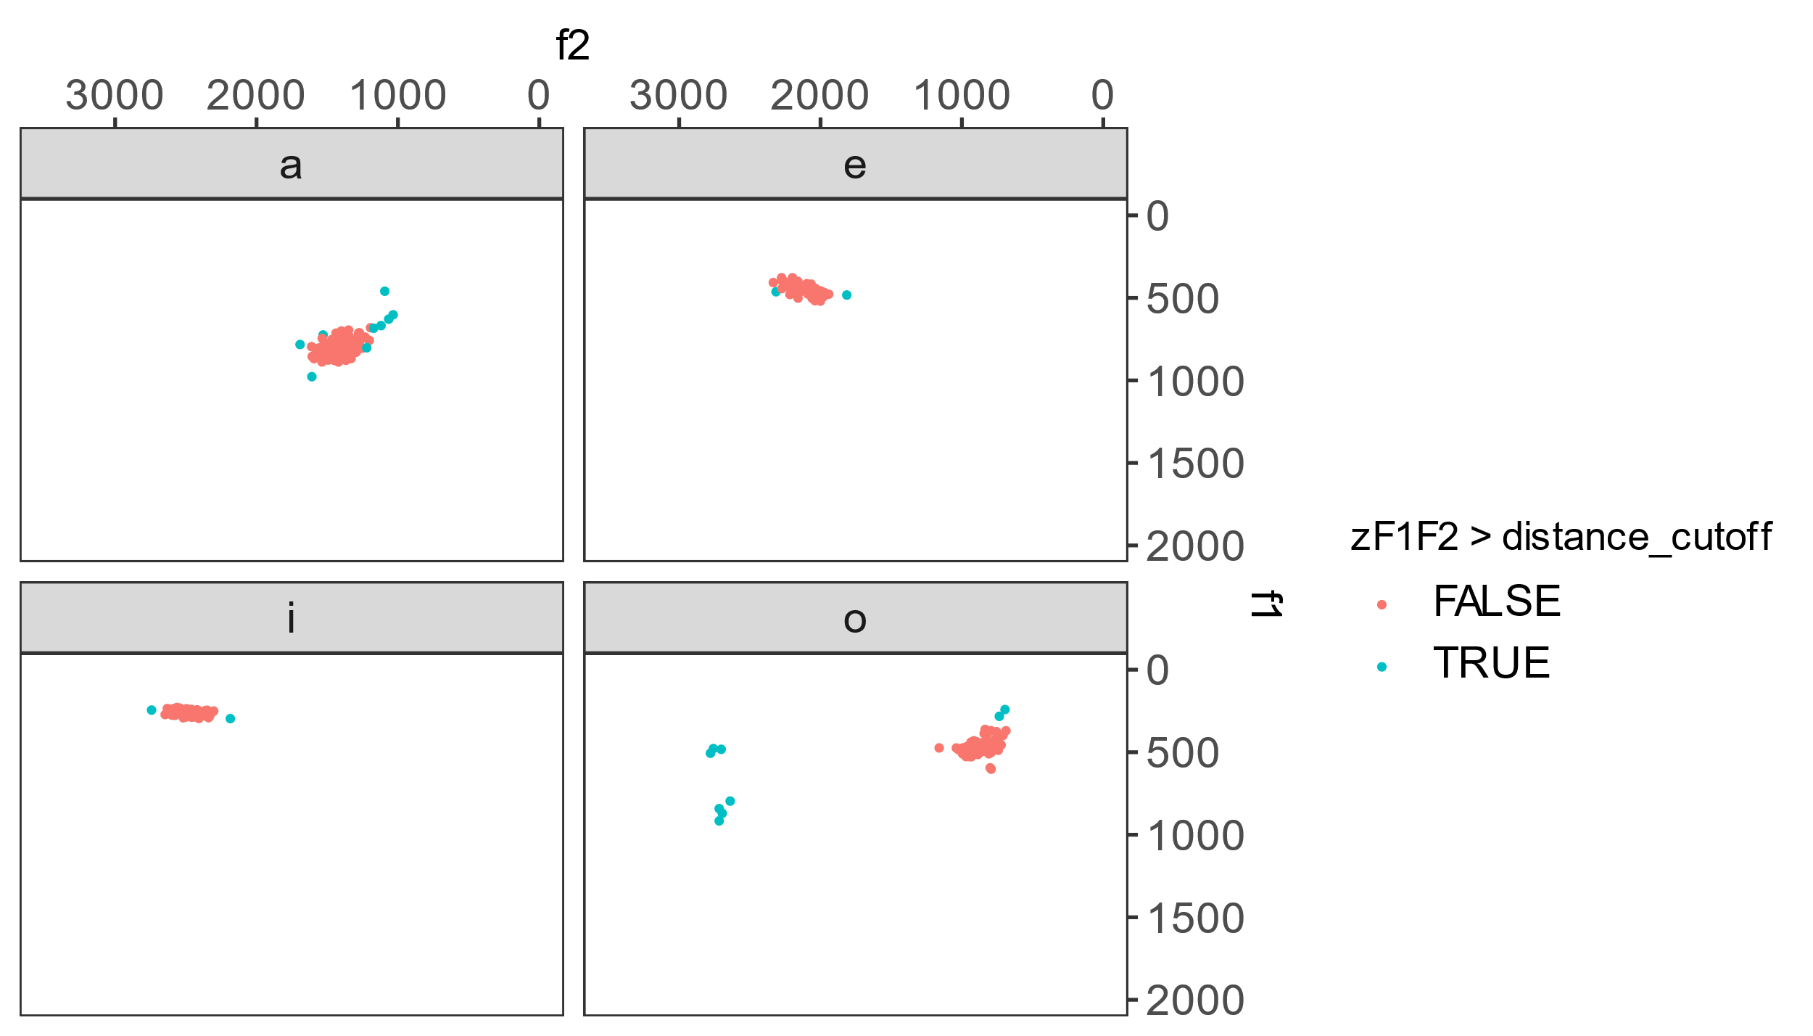
Outlier detection for f0 and harmonic measures (personal recommendation)
Formant tracking error detection:
For each vowel, calculate the Mahalanobis distance from each token to the center of that category. Tokens with a Mahalanobis distance larger than threshold are regarded as outliers (Garellek & Esposito, 2021; Seyfarth & Garellek, 2018).

Slide 51
Outlier detection for f0 and harmonic measures (personal recommendation)
Harmonic amplitude outlier detection:
Exclude tokens with f0 errors
Exclude tokens with formant errors
Exclude tokens with z-score larger than 3

Slide 52
Take-home message
VoiceSauce is a tool for analyzing acoustics of sound signals;
Its advantage are:
Able to process a large batch of sound files in one sitting;
Able to calculate parameters relating to voice quality;
Able to compare different algorithms for one measure (e.g. F0, formants);
The output is in a tab-delimited format and is ready to be passed on to statistical tests and data visualization.

Slide 53
Appendix: Measure explanation
H1c, H2c, H4c: The amplitude of H1, H2, H4 after being corrected for formant(s)
A1c, A2c, A3c: The amplitude of the harmonic closest to F1, F2, F3 after being corrected for formant(s)
H2Kc: The amplitude of the harmonic closest to 2K after being corrected for formants
H1H2c, H2H4c, H1A1c, H1A2c, H1A3c, H42Kc, H2KH5Kc: H1-H2, H2-H4, H1-A1, H1-A2, H1-A3, H4-H2K, and H2K-H5K after being corrected for formants
CPP: Cepstral Peak Prominence
Energy: Root-mean-squared energy of the signal

Slide 54
Appendix: Measure explanation
HNR05, HNR15, HNR25, HNR35: Harmonic-to-noise ratio between 0-500 Hz, 0-1500 Hz, 0-2500 Hz, and 0-3500 Hz
SHR: Subharmonic-to-Harmonic Ratio
H1u, H2u, H4u, A1u, A2u, A3u, H2Ku, H5Ku: The raw amplitude of H1, H2, H4, A1, A2, A3, H2K, H5K
H1H2u, H2H4u, H1A1u, H1A2u, H1A3u, H42Ku, H2KH5Ku: The raw difference of H1-H2, H2-H4, H1-A1, H1-A2, H1-A3, H4-H2K, H2K-H5K
strF0: f0 calculated used STRAIGHT algorithm
sF0: f0 calculated using SNACK algorithm
pF0: f0 calculated using PRAAT
shrF0: Subharmonic-to-Harmonic f0; represent the perceived f0 when there is subharmonics (diplophonia) (Sun 2002)
oF0: other f0. Used to calculate f0 using your own algorithm

Slide 55
Appendix: Measure explanation
sF1, sF2, sF3, sF4: F1, F2, F3, F4 calculated using SNACK algorithm
pF1, pF2, pF3, pF4: F1, F2, F3, F4 calculated using PRAAT
oF1, oF2, oF3, oF4: F1, F2, F3, F4 calculated using your own algorithm
sB1, sB2, sB3, sB4: Bandwidth of F1, F2, F3, F4 using SNACK algorithm
pB1, pB2, pB3, pB4: Bandwidth of F1, F2, F3, F4 using PRAAT
oB1, oB2, oB3, oB4: Bandwidth of F1, F2, F3, F4 using your own algorithm
epoch: the time point of the peak of each pulse
SoE: Strength of Exicitation; the energy of the peak of each pulse.

Slide 56
References
Iseli, Markus, Yen-Liang Shue, and Abeer Alwan. 2007. “Age, Sex, and Vowel Dependencies of Acoustic Measures Related to the Voice Source.” The Journal of the Acoustical Society of America 121 (4): 2283–95. https://doi.org/10.1121/1.2697522.
Garellek, Marc, and Christina M. Esposito. 2021. “Phonetics of White Hmong Vowel and Tonal Contrasts.” Journal of the International Phonetic Association, 1–20. https://doi.org/10.1017/S0025100321000104.
Seyfarth, Scott, and Marc Garellek. 2018. “Plosive Voicing Acoustics and Voice Quality in Yerevan Armenian.” Journal of Phonetics 71 (November): 425–50. https://doi.org/10.1016/j.wocn.2018.09.001.
Shue, Yen-Liang, Patricia Keating, Chad Vicenik, and Kristine M. Yu. 2011. “VoiceSauce: A Program for Voice Analysis.” In Proceedings of the 17th International Congress of Phonetic Science, 1846–49. Hong Kong.

